Slide 1
Neuromend
By Tempest
An ICT313 Games Technology Project
Murdoch University
Ary Bizar, Anopan Kandiah, Hannah Klinac, Alex Mlodawski, Bryan Yu

Slide 2
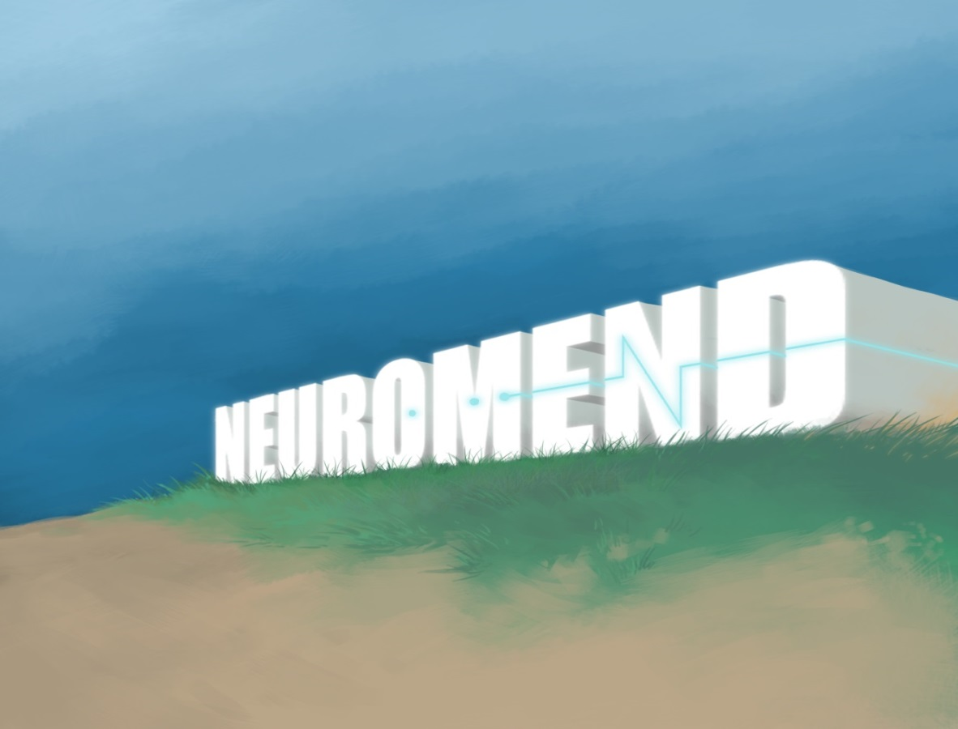
Outline
Introduction
Project background
Project requirements
The solutions
Our approach
Live demonstrations
Final status
Future possibilities
Lessons learned
Questions?

Slide 3
Project Introduction
Project Name: Neuromend
Client: Shri Rai, Murdoch School of Engineering & IT
Supervisor: Fairuz Shiratuddin
Tempest:
Ary Bizar (Bsc, Games Technology, Games Art and Design)
Level designer, Asset creator
Anopan Kandiah (Bsc, Computer Science, Games Technology)
Kinect development
Hannah Klinac (Bsc, Computer Science, Games Technology)
Leap Motion development, Project Manager
Alex Mlodawski (Bsc, Computer Science, Games Technology)
Kinect development
Bryan Yu (Bsc, Computer Science, Games Technology)
Razer Hydra development, Database

Slide 4
Project Background
Stroke
Parts of the brain may be damaged or may die
This can result some loss of motor control
One form of rehabilitation is rewiring
Rehabilitation
Accessibility
Money
Tedious/boring – no incremental goals
Limited
Notes:
HELPING PEOPLE

Slide 5
Project Specifications & Requirements
Specifications
This idea of simulation rehabilitation inducing rewiring is a theory that has been shown to work elsewhere
This project is one of the first steps toward establishing a stroke rehabilitation system
This project involves developing the prototype platform
Testing will be done next semester
Requirements
Create a virtual simulation
Design and develop 3 different tasks
Utilize natural user interfaces devices
Design and develop sensitivity adjustor
Design and develop to support profiling and database
to keep track of progress
Notes:
Project was initially created to evaluate the devices to see what could work well for a solution
Determined that the project was useful enough to be used in a practical setting
This project is essentially an evaluation step towards a more concrete implementation

Slide 6
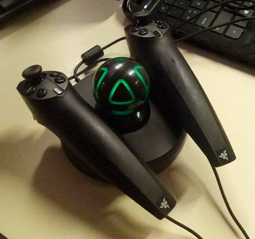
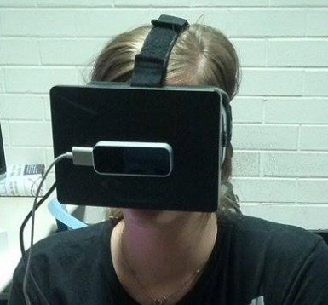
The Solutions
The main system must have:
Virtual environments
3 different tasks that require different movements
Object Manipulation
Obstacle Avoidance
Way Finding
Natural user interfaces* devices (providing different accessibilities) used in conjunction with Oculus Rift (the main display)
Keyboard and mouse* (control device)
Razer Hydra
Kinect
Leap Motion
Sensitivity and other adjustable settings
Provide incremental goals
Monitoring progress – can be assessed
Profiles on an external database

Slide 7
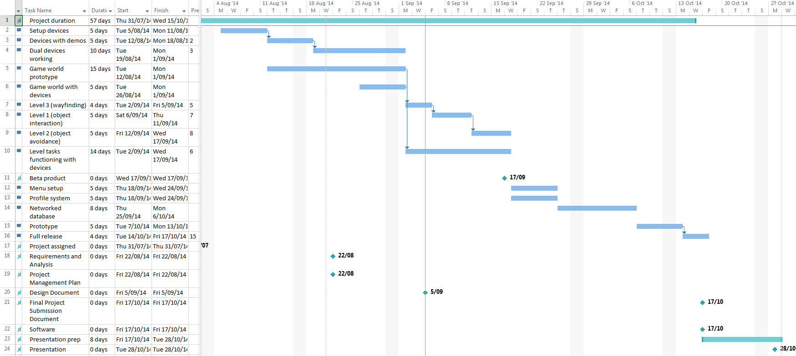
Project Management
Iterative (SCRUM) methodology with weekly sprints
Weekly team/supervisor meetings
Communication
Project room
Facebook group
Source code control
GitHub
Notes:
Weekly team meetings: discussed requirements, issues and demonstrated progress and prototypes
*How the project was managed
*How the team was managed
Work breakdown
Work assignment

Slide 8
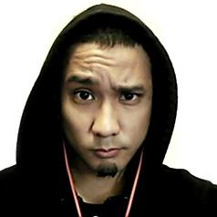
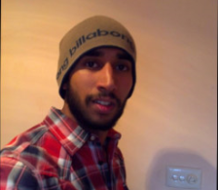
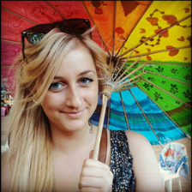
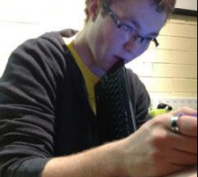

Project Management Team
Ary Bizar – Level designer, Asset creator, Mouse & keyboard development
Anopan Kandiah – Kinect development
Hannah Klinac – Leap Motion development, Project Manager
Alex Mlodawski – Kinect development
Bryan Yu – Razer Hydra development, Profiling and Database
Notes:
Work breakdown
Work assignment

Slide 9
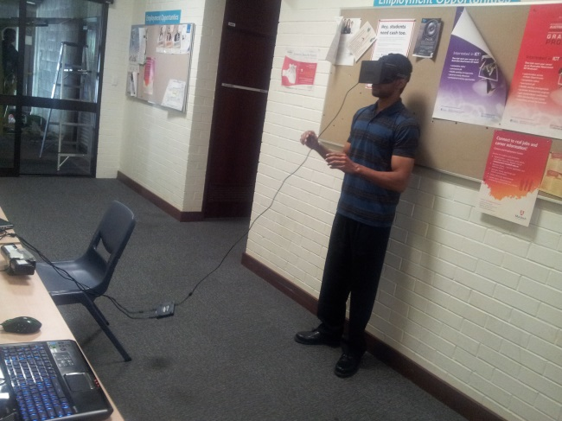
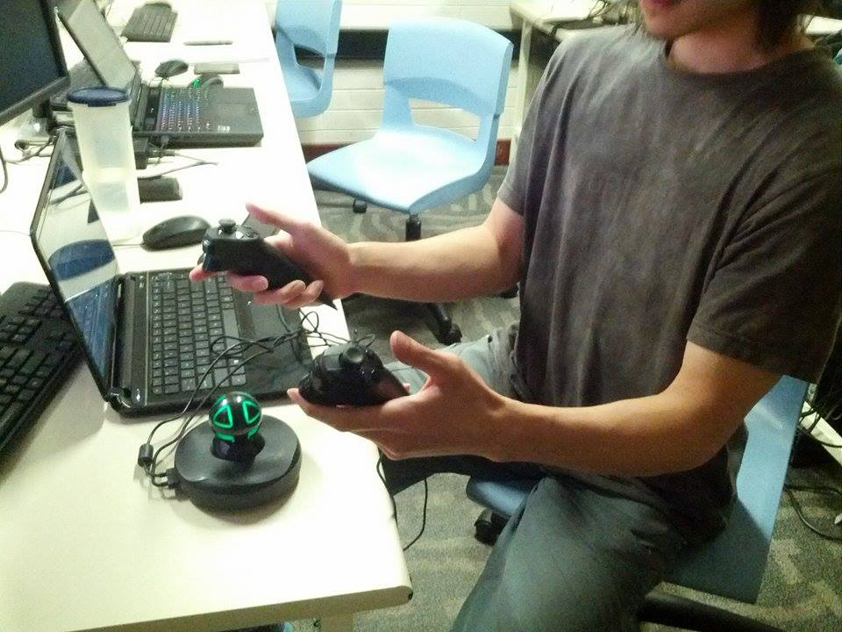
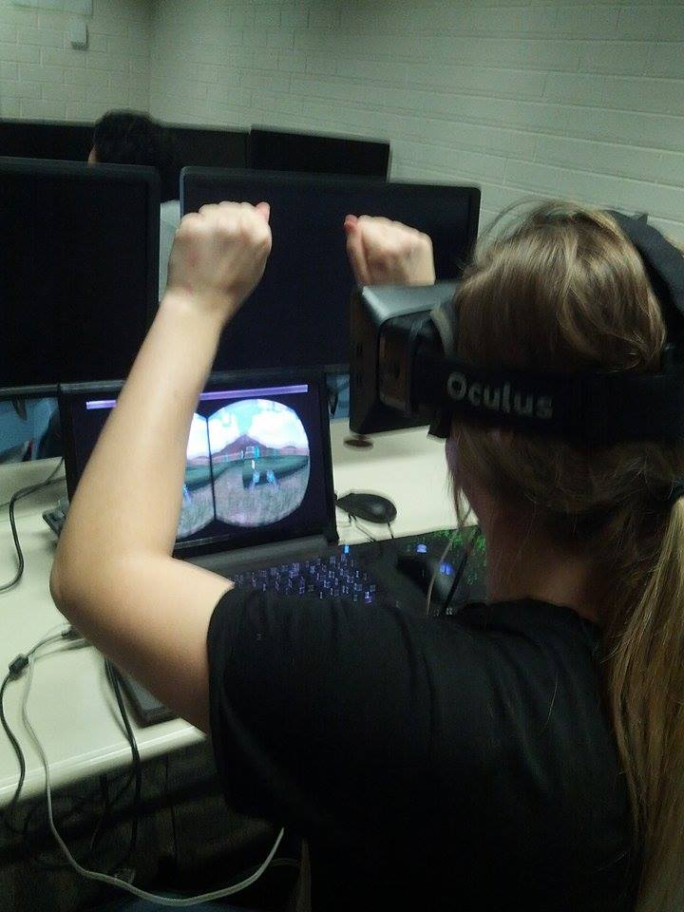
Technologies Utilized
Main system was developed using Unity and coded using C#
Visual assets
3DS Max
Mudbox
Photoshop
Database and profiling system
MySQL
ClearDB
Hardware
Oculus Rift DK1
0.4.0 SDK
Razer Hydra
Sixense SDK
Kinect v1 for Windows
V1.8 SDK
Leap Motion
V2 Tracking API, 2.1.5 SDK

Slide 10
Video
Menu
Adjustors
Profiling
Oculus Rift – To make it easier for the audience to view, we’re only using the Oculus with one of the input interfaces today

Slide 11
Live Demonstration Kinect – “Object Avoidance” task
Object Avoidance
Kinect actions
Able bodied
Heightened sensitivity

Slide 12
Live Demonstration Razer Hydra – “Object Manipulation” task
Object Manipulation
Razer Hydra actions
Able bodied
Heightened sensitivity

Slide 13
Live Demonstration Leap Motion – “Way Finding” task
Way Finding
Leap Motion actions
Able bodied
Heightened sensitivity
Tracks all 10 fingers up to 1/100th of a millimeter
Beta product

Slide 14
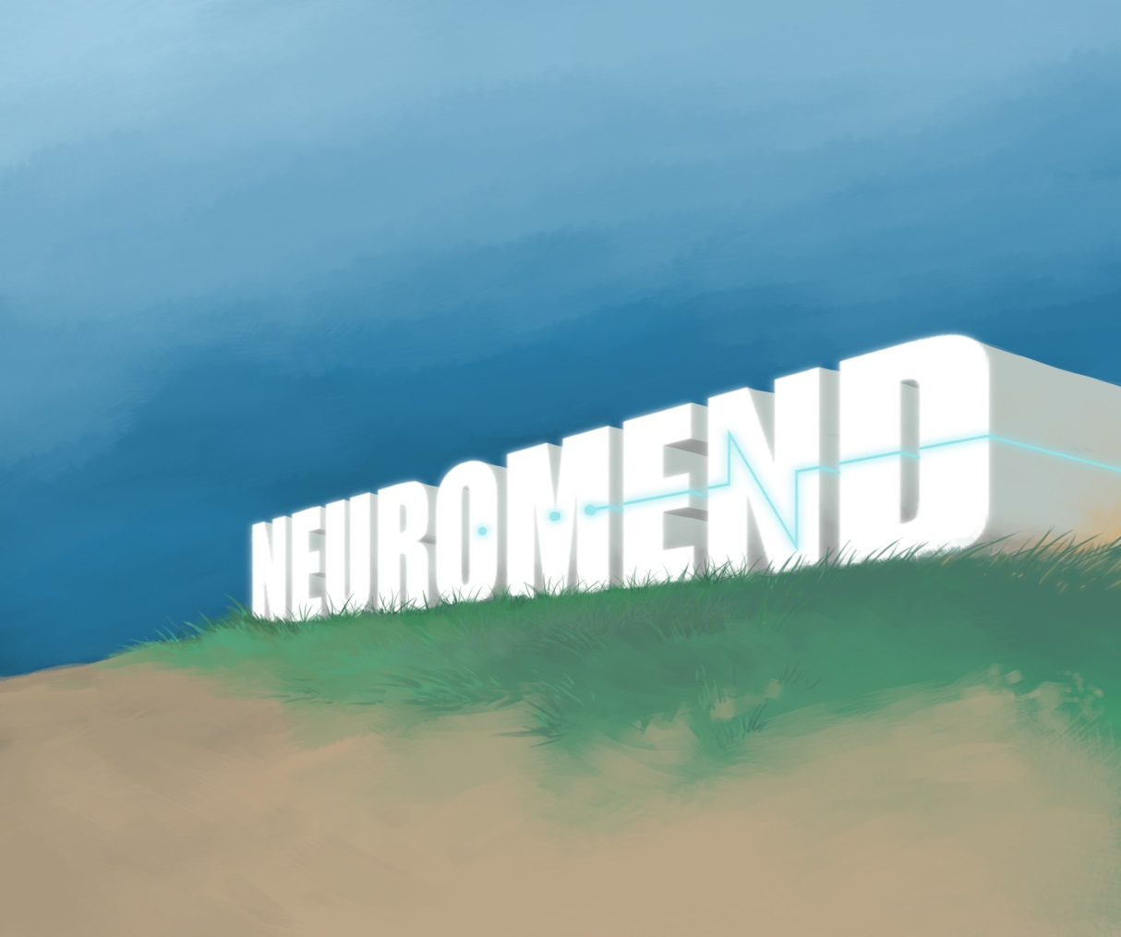
Final Status
Requirements
Virtual Simulation
3 different tasks
NUIs Devices
Sensitivity adjustor
Profiling
Database
Playable by anyone
Interesting and enjoyable
Extensible
The project is now in a position
to be extended for deployment into practical use

Slide 15
Future Possibilities
Clinical use
The system will be tested soon
Additional control schemes
Speech
EEG
Records brain wave patterns
Monitoring variables to self improve the system
Stress
Support for future version of the NUI’s devices
Oculus Rift DK2
Kinect 2
Tobii Eye Tracker
Leap Motion release
Sixense stem motion tracking system
Virtuix treadmill

Slide 16
Lessons Learned
Devices
Beta products and development kits
Drivers clashing
Versions/compatibility
Designing the tasks and the movements/gestures to meet requirements and to also consider the devices and what they can do
Version control and modifying joint code
Teamwork
Decisions
Conflict resolution
Communication is essential for success
The importance of time management
Assess and managing scope

Slide 17
Acknowledgements
Client – Mr Shri Rai
Supervisor – Dr Fairuz Shiratuddin
Ayden-James Nolan – Music
Elly Thompson - Sounds

Slide 18
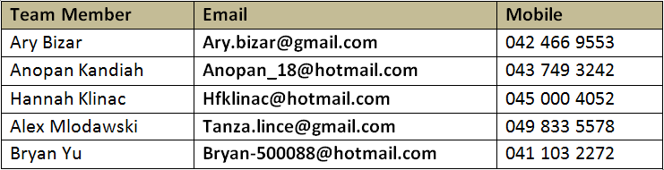
Questions?

